Slide 1



Control Structures
Topic 4
Switch ..case

Slide 2


What is Switch ..case?
Similar to an if statement, a switch statement allows a variable/expression to be examined against a list of options.
Each option is called a case, and for each case, different tasks can be performed.

Slide 3
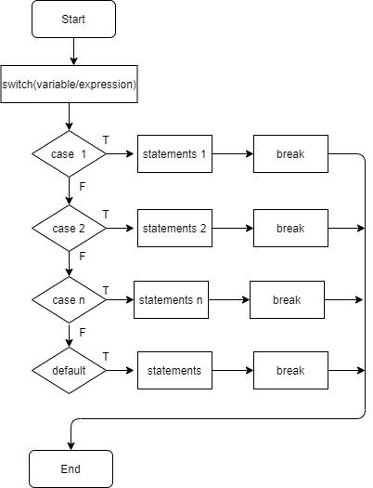
Switch Structure

Slide 4
Switch..case Syntax
switch (variable/expression)
{
case value1: statements1
break;
case value2: statements2
break;
...
case valuen: statementsn
break;
default: statements
break;
}

Slide 5
Nested If & Switch statement
int month = 2;
if (month == 1) System.out.println("Month is Jan");
else if (month == 2) System.out.println("Month is Feb");
else if (month == 3)
System.out.println("Month is March");
else
System.out.println("Not the first quarter of the year");
int month = 2;
switch (month){ case 1: System.out.println("Month is Jan");break;
case 2: System.out.println("Month is Feb"); break;
case 3: System.out.println("Month is March"); break;
default: System.out.println("Not the first quarter of the year");
}

Slide 6
The Break statement
Often a break statement is used as the last statement in each case's statement list.
A break statement causes control to transfer to the end of the switch statement.
If a break statement is not used, the flow of control will continue into the next case.

Slide 7
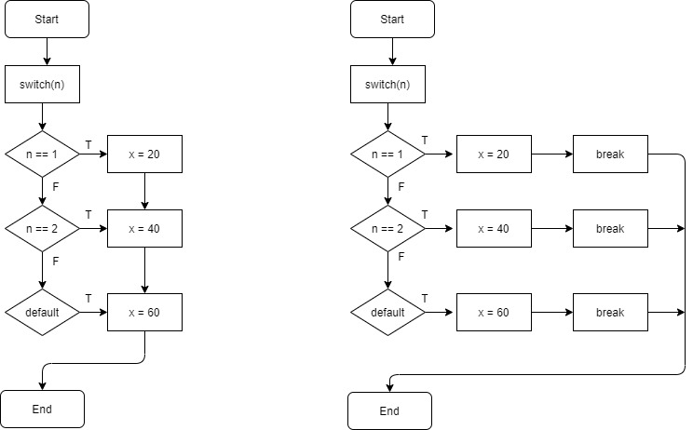
Control flow of Switch statement with and without the Break statements
switch (n){
case 1: x = 20;
case 2: x = 40;
default: x = 60;
}
switch (n){
case 1: x = 20; break;
case 2: x = 40; break;
default: x = 60; break;
}

Slide 8
Switch Examples
int m = 2;
switch (m)
{
case 1 :
System.out.println("m=1");
break;
case 2 :
System.out.println("m=2");
break;
case 3 :
System.out.println("m=3");
break;
default:
System.out.println("default");
break;
}
char ch = ‘b’;
switch (ch)
{
case ‘a’ :
System.out.println("ch=a");
case ‘b’ :
System.out.println("ch=b");
case ‘c’ :
System.out.println("ch=c");
default:
System.out.println("default");
break;
}
Output:
m=2
Output:
ch=b
ch=c
default

Slide 9
Switch Examples
char letter = 'B'; switch (letter) { case 'A': case 'a': System.out.println("You chose A");
break; case 'B': case 'b': System.out.println("You chose B");
break; default: System.out.println("You chose other than A & B");
break; }
if((letter == ‘A’) || (letter == ‘a’))
System.out.println("You chose A");

Slide 10
Switch and nested If Example
int number=1, x = 2; if (x>=1 && x<=3)
number++;
else if (x == 4)
number += 4;
else
number+=5;
int number=1, x = 2; switch (x) { case 1: case 2: case 3: number++; break; case 4 : number+=4; break; default: number+=5; break; }
int number=1, x = 2; if (x==1 || x==2 || x==3)
number++;
else if (x == 4)
number += 4;
else
number+=5;

Slide 11
switch Example
What is the value of j after these switch statements?
int i = 1; int j = 0;
switch (i+1) { case 0: j = 0; case 1: j = 1; case 2: j = 3; default: j = -2; }
int i = 1; int j = 0;
switch (i+1) { case 0: j = 0;break; case 1: j = 1;break; case 2: j = 3;break; default: j = -2;break; }
j=-2
j=3

Slide 12
Exercise
Rewrite the following if statement using a switch:
int selection;
System.out.print("Enter your selection: "); selection = scan.nextInt(); if (selection == 1) System.out.println("You selected JAVA");
else if (selection == 2) System.out.println("You selected VISUAL BASIC");
else if(selection == 3) System.out.println("You selected PHP");
else System.out.println("Invalid selection");

Slide 13
Exercise
Rewrite the following switch using if else statement :
int number=1, x = 2; switch (x) { case 1: case 2: case 3:
case 4: number = number *2; break; case 5 : number = number *5; break; default: number--; break; }
int number=1, x = 2; if (x>=1 && x<=4)
number = number *2;
else if (x== 5)
number = number *5;
else
number--;

Slide 14

TODAY’S TAKE AWAY
Switch selection control structure.
Nested If & Switch statement.
Break statement.

